Slide 1
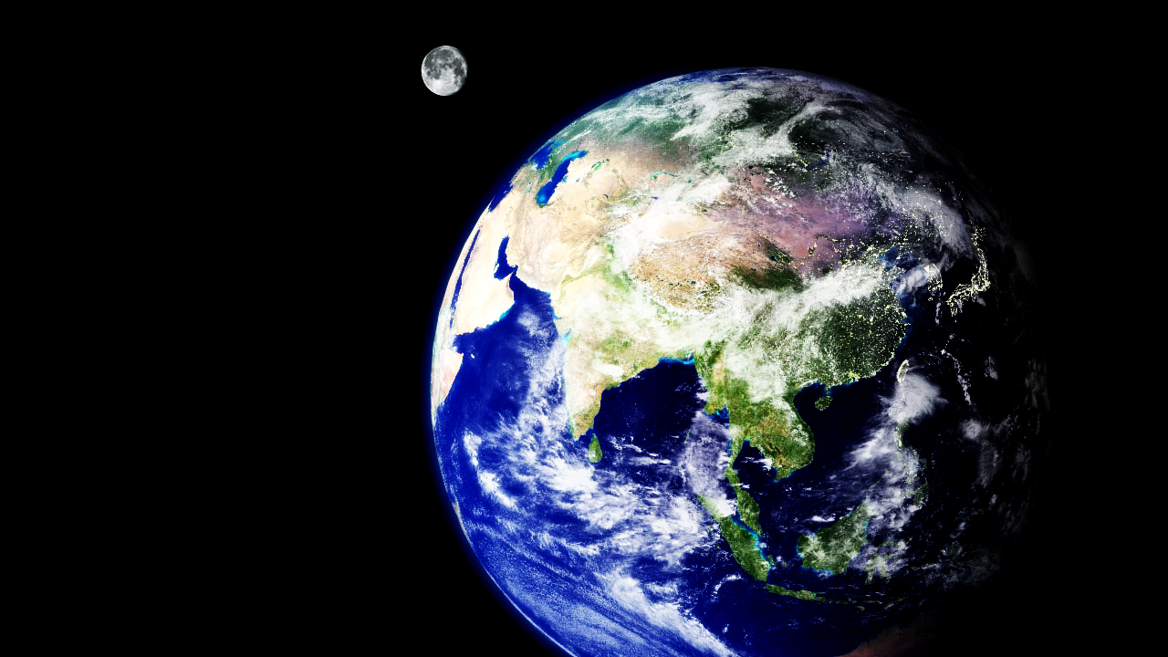
GRAVITY IN SPACE
We will explain orbits using gravity

Slide 2
Repeat the opposite word/phrase.
CONTACT FORCES
PHYSICAL CONTACT

Slide 3
Categorise all the forces you know into contact and non-contact.
Provide a reason for each one (first one is done for you).
Contact Forces | Non-Contact Forces
Friction- the ground touches the moving object opposing its motion

Slide 4
Repeat the opposite word/phrase.
NON-CONTACT FORCES
NO PHYSICAL CONTACT

Slide 5
Repeat the opposite word/phrase.
GRAVITY
PULL TOWARDS EARTH

Slide 6
Repeat the opposite word/phrase.
WEIGHT
MEASUREMENT OF GRAVITY

Slide 7
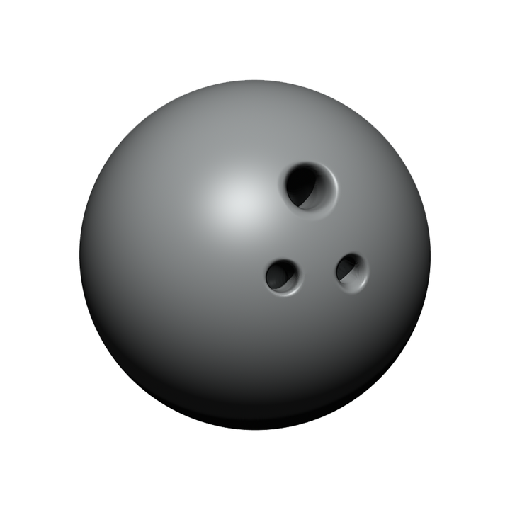

If a bowling ball and a basketball were dropped at the same time, which would hit the ground first?
A - Bowling ball
B - Basketball
C - Same time

Slide 8
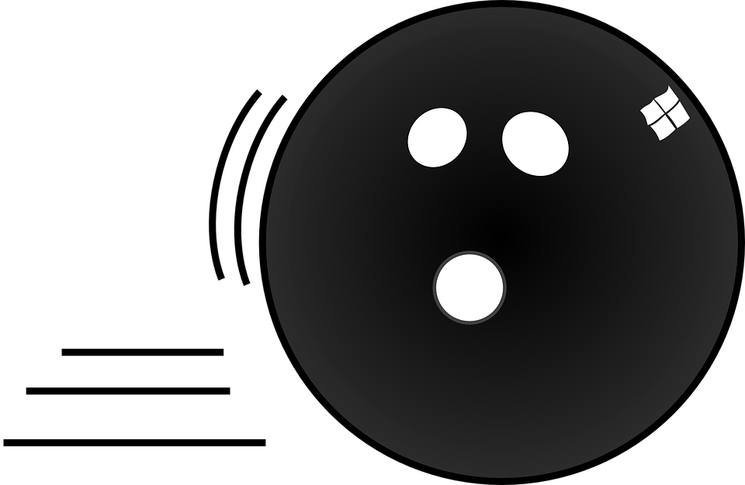
Which arrow represents the friction force? Justify your answer.
A
B

Slide 9
We will explain₁ orbits using gravity
TRACK WITH ME
READ WITH ME
We will define orbit
We will use gravity to describe the Earth’s movement around the Sun
We will use gravity to describe the Moon’s movement around the Earth
DEFINITION
1 - describe
DECLARE THE OBJECTIVE
Read the learning objective to your partner.
Notes:
Learning Objectives contain concepts (nouns, big ideas), skills (verbs, measurable behaviours) and sometimes context (restricting or targeting conditions).
●Example: Students will be able to describe the concept of density and apply it to floating and sinking.
●
Success criteria are specific measurable outcomes that if met mean that the student has met the learning objective.
Examples:
•Students will be able to compare densities of substances using mass and volume.
•Students will be able to identify whether a solid or liquid will float or sink in a liquid based on their densities.

Slide 10
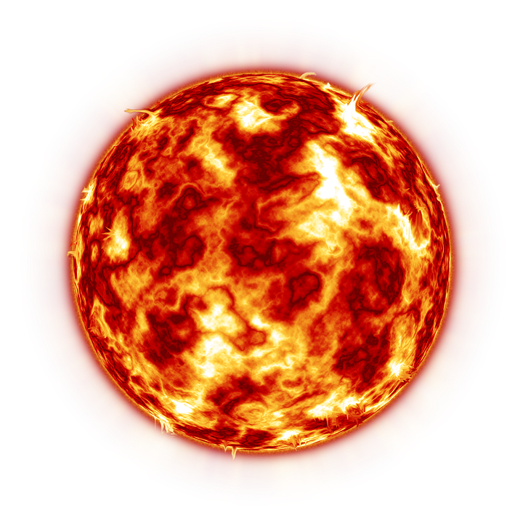
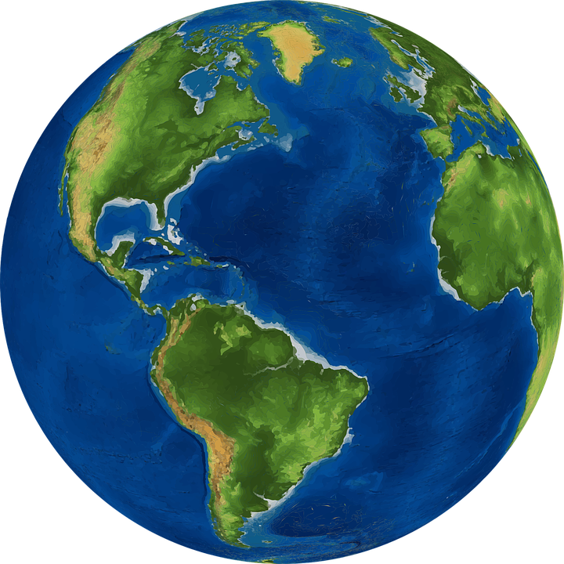
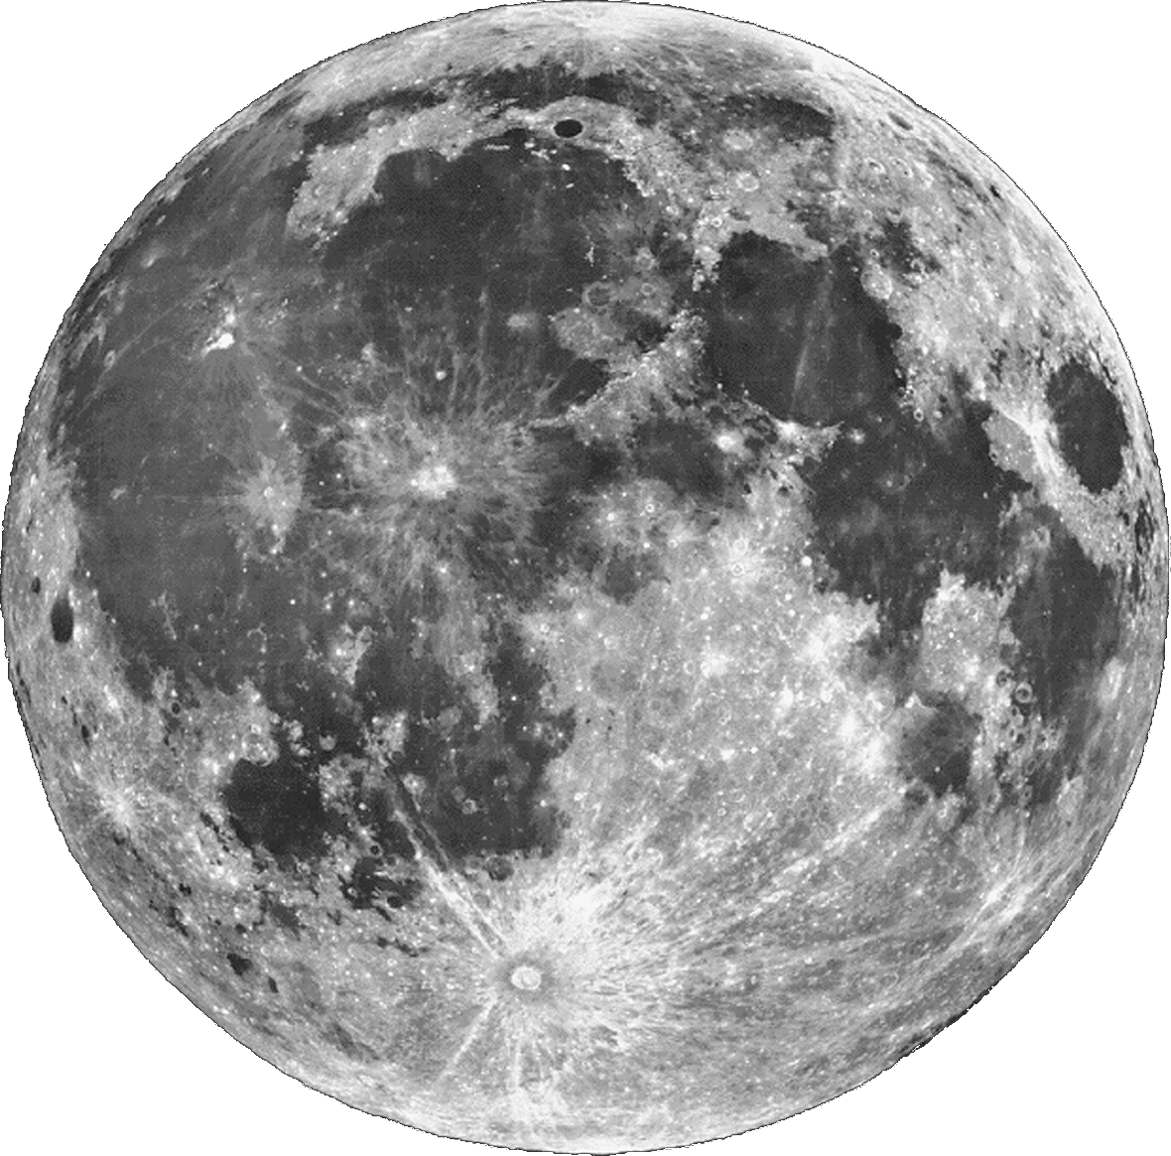
We will explain orbits using gravity
Every object made from matter₂ has a gravitational field. The more matter an object has, the stronger it is.
Please rank the following from strongest gravitational field, to weakest gravitational field.
SUN EARTH MOON
MAKE THE CONNECTION
Students, you already know that gravity is a force that pulls objects towards the centre of the Earth.

Slide 11
We will explain orbits using gravity
The Sun has so much mass₁ that its gravity affects all planets and moons in our solar system.
All planets revolve₂ around the Sun, which is called an orbit.
The Earth orbits the Sun.
The Moon orbits the Earth.
CHECK FOR UNDERSTANDING
Explain why the planets orbit the Sun?
DEFINITION
1 - amount of matter 2 - circle

Slide 12
We will explain orbits using gravity
Planets move and as they move forward through space, the Sun’s gravity pulls them in.
There is a small force attracting the Sun to the Earth due to Earth’s gravity.
This small gravity force and the force of the planet moving forward balance with the force from the Sun’s gravity resulting in the orbit.
CHECK FOR UNDERSTANDING
Why is the gravity force from the Sun stronger than the gravity force from Earth?

Slide 13
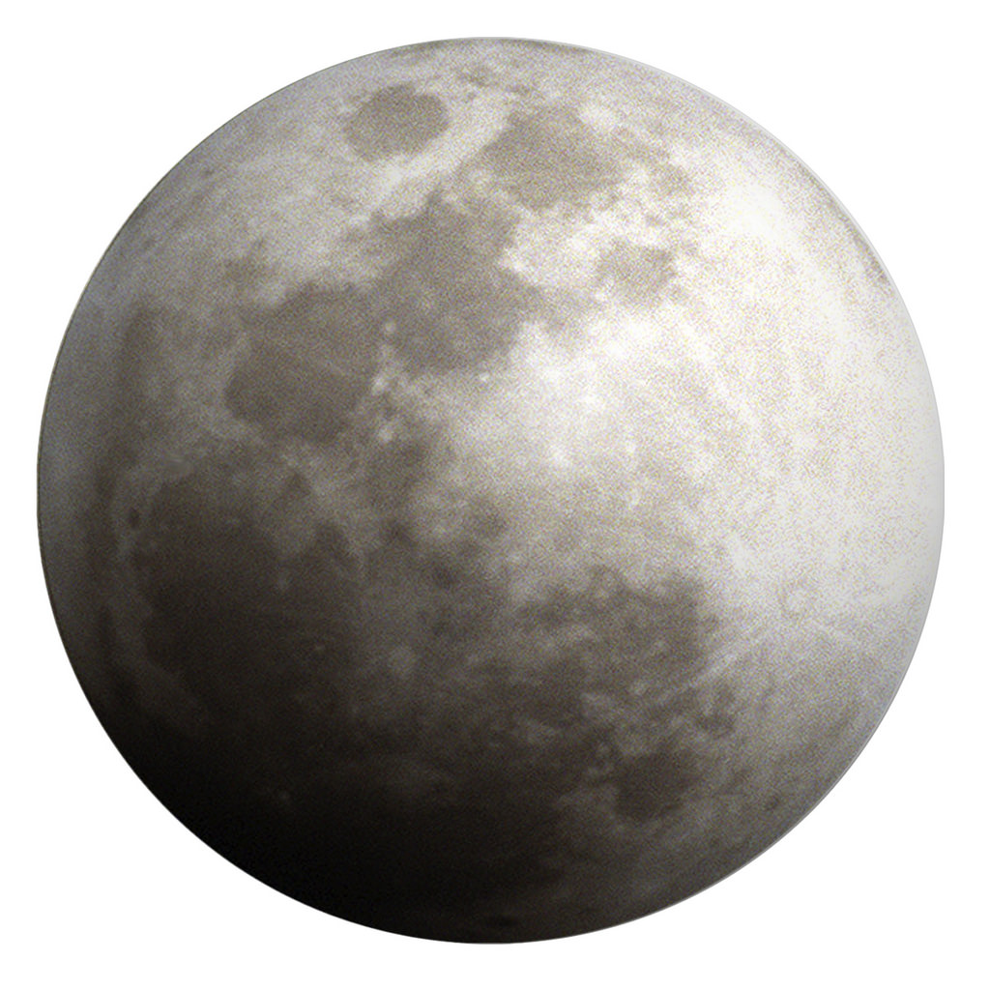
We will explain orbits using gravity
The same forces are the reason why the Moon orbits around the Earth.
There is a small force attracting the Earth to the Moon due to the Moon’s gravity.
This small gravity force and the force of the Moon moving forward balance with the force from the Earth’s gravity resulting in the orbit.
CHECK FOR UNDERSTANDING
Why is the gravity force from the Sun stronger than the gravity force from Earth?

Slide 14
We will explain orbits using gravity
Draw the Earth orbiting the Sun using the arrows and shapes below.
CHECK FOR UNDERSTANDING
Why doesn’t the Earth just break away from the Sun’s orbit?
REMEMBER THE CONCEPT
Remember that all planets orbit the Sun and the Moon orbits the Earth. Orbits are due to gravity forces.

Slide 15
We will explain orbits using gravity
Gravity is the reason why the Earth orbits the Sun and the Moon orbits the Earth.
These forces are the reason why we use years and months as measurements of time.

Slide 16
We will explain orbits using gravity
All planets revolve₁ around the Sun, which is called an orbit.
The Earth orbits around the Sun due to its enormous gravitational field.
The Moon orbits around the Earth due to its gravitational field.
DEFINITION
1 - circle

Slide 17
We will explain orbits using gravity
Answer the questions below about orbits in our solar system.
If a planet was smaller than Earth, describe its gravity.
Saturn is known for its rings. Explain why the rings stay around Saturn.
Satellites which orbit Earth are not powered. Explain why they stay in orbit.
REMEMBER THE CONCEPT
Remember that all planets orbit the Sun and the Moon orbits the Earth. Orbits are due to gravity forces.
Notes:
Please include tasks/questions here rather than just referring to a worksheet. This will save on photocopying and facilitate sharing with other schools.
Try and build tasks/questions which escalate through Bloom’s Taxonomy. This will help with differentiation.

Slide 18
We will explain₁ orbits using gravity
We will define orbit
We will use gravity to describe the Earth’s movement around the Sun
We will use gravity to describe the Moon’s movement around the Earth
DEFINITION
1 - describe
CHECK FOR UNDERSTANDING
Check Success Criteria.

